Slide 1
Enhancing Customer Experience: A Comprehensive Framework for Contextual Product Question Answering by Ujjwal (BT22CSD031) Abhiudai Shahi (BT22CSD040) Nayan Mandal (BT22CSD035) Under the Supervision of Ms. Madhuri Dubey
INDIAN INSTITUTE OF INFORMATION TECHNOLOGY, NAGPUR
(An Institution of National Importance by Act of Parliament)

Slide 2
Objectives
Process and Analyze Structured Product Data: Utilize structured data, such as product specifications and metadata, to extract meaningful insights that enhance product understanding,
optimize search relevance, and improve decision-making processes for both customers and businesses.
Extract Insights from Unstructured Data: Leverage advanced techniques to analyze unstructured data, including customer reviews, feedback, and queries, to gain deeper insights into customer preferences, pain points, and satisfaction levels, driving continuous improvement in customer experience.
Visualize Consumer Behavior Trends: Develop dynamic visualizations to uncover and communicate patterns in consumer behavior, such as purchasing trends, sentiment shifts, and preferences, empowering data-driven strategies and business decisions.

Slide 3
Background
The background of this project lies in the increasing reliance on user-generated content like reviews and ratings in shaping consumer behavior, particularly on e-commerce platforms. With vast amounts of unstructured text data being generated, businesses face the challenge of extracting meaningful insights to improve products, services, and customer experiences.
By leveraging data science and NLP, the project addresses the need for scalable, accurate sentiment classification and trend analysis. It builds on modern advancements in transformer-based models and data visualization, bridging the gap between raw data and actionable business intelligence.

Slide 4
Features
Comprehensive Data Integration: The project seamlessly merges structured data (e.g., product metadata) with unstructured data (e.g., user reviews) to enable a holistic analysis. This integration ensures that insights are derived from all available information, offering a richer understanding of user sentiment and product trends.
Advanced NLP and Sentiment Analysis: Leveraging transformer-based NLP models, the system performs sentiment classification and semantic analysis with high accuracy. These models, powered by libraries such as Hugging Face Transformers and PyTorch, analyze user opinions deeply, capturing nuanced emotional tones and contextual meaning.

Slide 5
Custom Analytics Framework: A dedicated Python class, ProductAnalyzer, encapsulates key functionalities like data ingestion, preprocessing, and visualization. This modular approach ensures efficiency and reusability, streamlining tasks such as sentiment classification, trend analysis, and actionable insights extraction.
Interactive and Insightful Visualizations: The project uses advanced visualization libraries like matplotlib and seaborn to create intuitive graphs and charts. These visualizations display sentiment trends, common themes in reviews, and distributions, making complex data comprehensible and actionable for decision-makers.
Scalable and Future-Oriented Design: Built with scalability in mind, the solution processes large datasets efficiently using pandas and NumPy. The architecture supports future extensions like real-time analysis, predictive modeling, and deployment in production environments, ensuring adaptability to evolving busines

Slide 6
Challenges
Despite its strengths, the project faces certain challenges and limitations. Processing large volumes of unstructured data can be computationally intensive, requiring significant resources. Additionally, NLP models, while powerful, are not immune to biases in the training data, which can affect the accuracy of sentiment analysis.
Another limitation is the static nature of the analysis, as the project relies on pre-existing datasets. Incorporating real-time data streams could enhance the analysis, enabling dynamic updates and more timely insights.
Dependency on API: The function relies on the Amazon API, making it vulnerable to changes in API structure, access restrictions, or downtime.

Slide 7
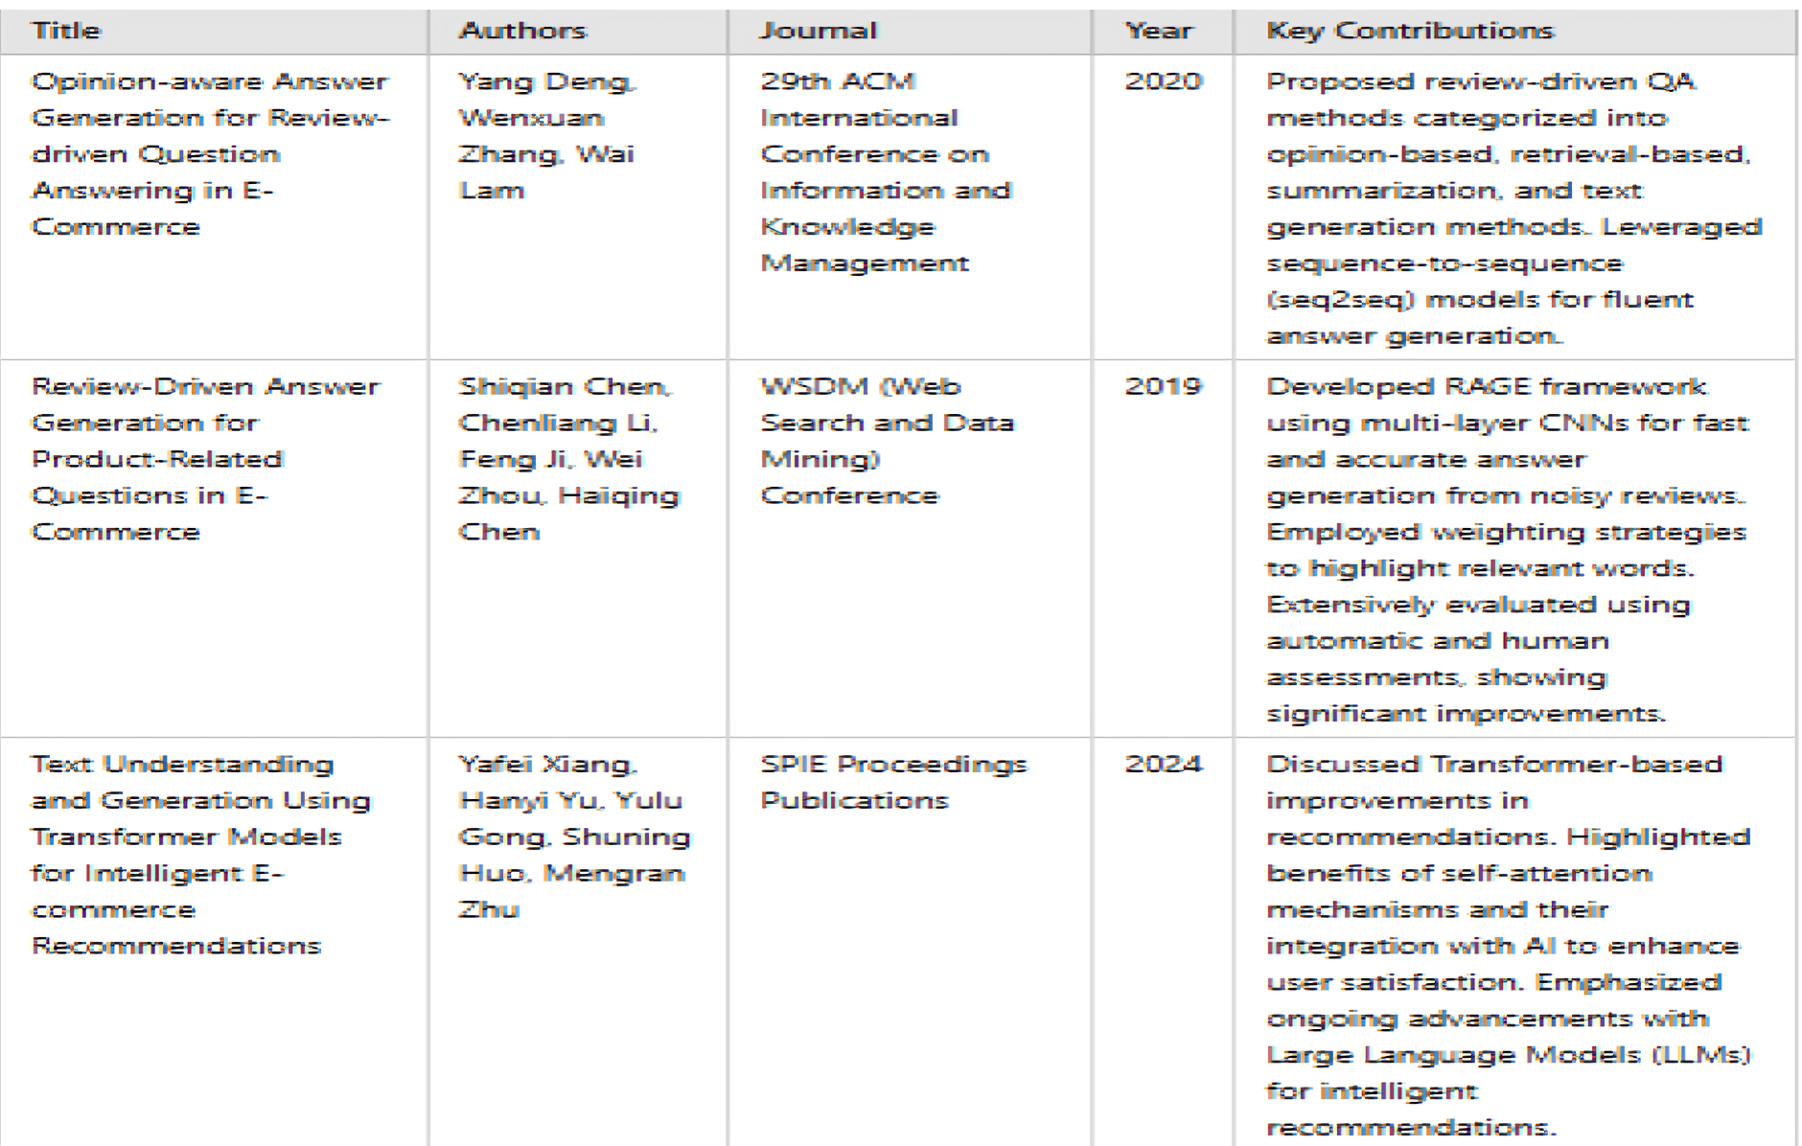
Literature Review

Slide 8
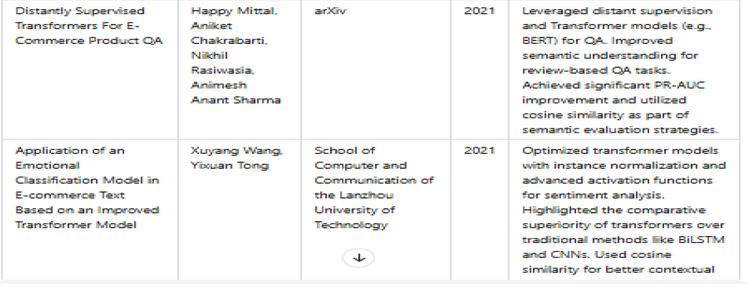

Slide 9
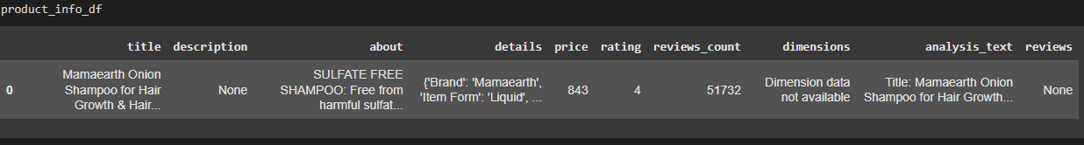
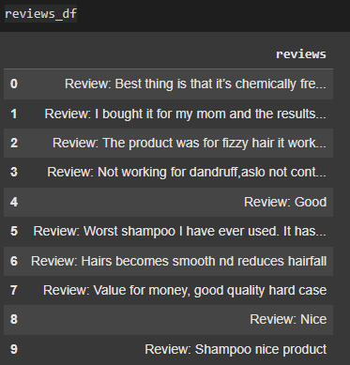
Information Fetching:-
The information about Amazon product is fetched using its ASIN(Amazon Standard Identification Number) and users rapid API key.
Product description
Latest 10 Customer Review

Slide 10
Data/Product information Preprocessing
1. Text Cleaning
Remove URLs/links
Normalize whitespace
Strip extra spaces
2. Text Compression
Limit to 512 characters
Append until limit
Truncate excess segments

Slide 11
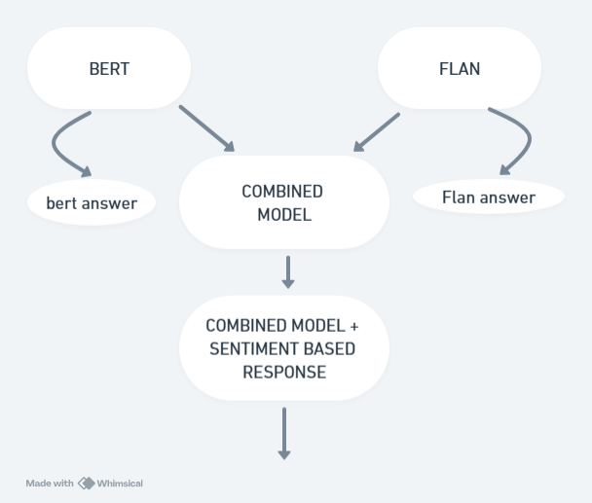
Methodology:-
User Input- ASIN , Question
Fetched Product Information
Generated Answers through Combined Bert & Flan model
Incorporated Sentiment analysis into it as uniqueness to our work.
(This sentiment based response to user’s question was never done before)
FLOW OF MODELS

Slide 12
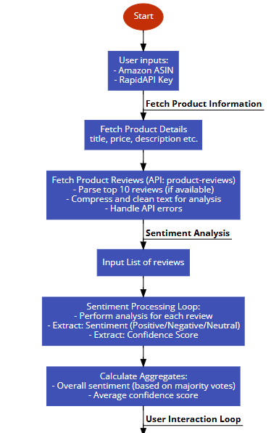
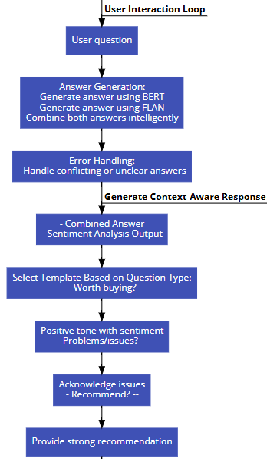
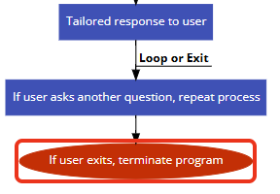
Model Architecture

Slide 13
Results:-
The developed e-commerce Question & Answer (Q&A) model, which combines the BERT and FLAN models along with sentiment analysis, achieved promising results. The following highlights key outcomes from the model evaluation:
Model Performance:
BERT Model: Achieved a similarity score of 69%, indicating a good level of contextual understanding but with room for improvement.
FLAN Model: Initially, the similarity score was 33%, reflecting a moderate alignment with the queries but not optimal in context-specific responses.
Combined Model: After integrating both BERT and FLAN, the combined model showed an improvement, achieving a similarity score of 73%. This indicates a more accurate and contextually relevant answer generation.

Slide 14
Sentiment Analysis Accuracy:
The sentiment analysis component of the model was able to predict the sentiment of user queries with 100% accuracy. This ensures that the responses are tailored according to the emotional tone of the user, enhancing customer satisfaction.
Enter your question about the product (or 'exit' to quit): Is it worth buying BERT Answer: price : 843 FLAN-T5 Answer: Yes Final Response: The customer reviews are overwhelmingly positive, highlighting the
product’s strengths. price : 843 .Yes Additionally, many customers believe this product is a great value for the price.
Sentiment based response

Slide 15
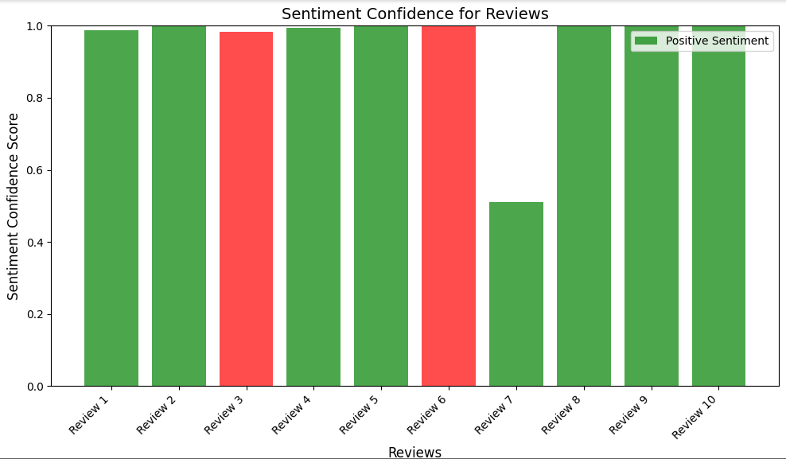
CONFIDENCE SCORE OF USER REVIEW (Red bar depicts negative sentiment & Green bar depicts positive user sentiment)

Slide 16
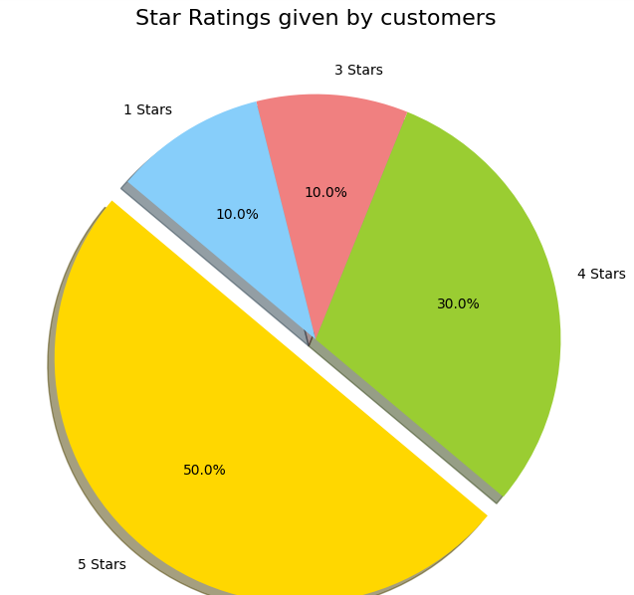
Percentage of Users giving 1*… 5 *

Slide 17
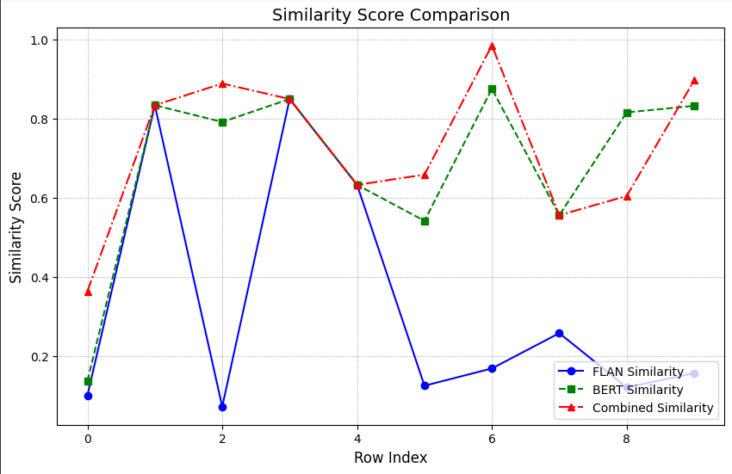
Combined model has better similarity score than bert and flan models

Slide 18
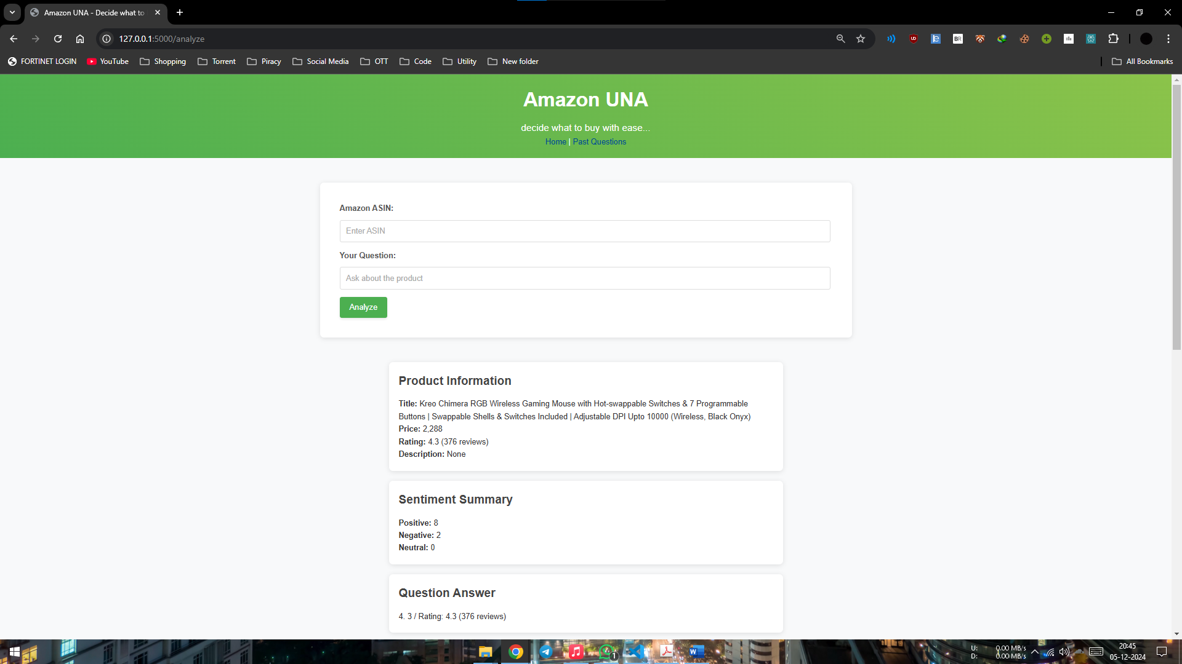
Final Website

Slide 19
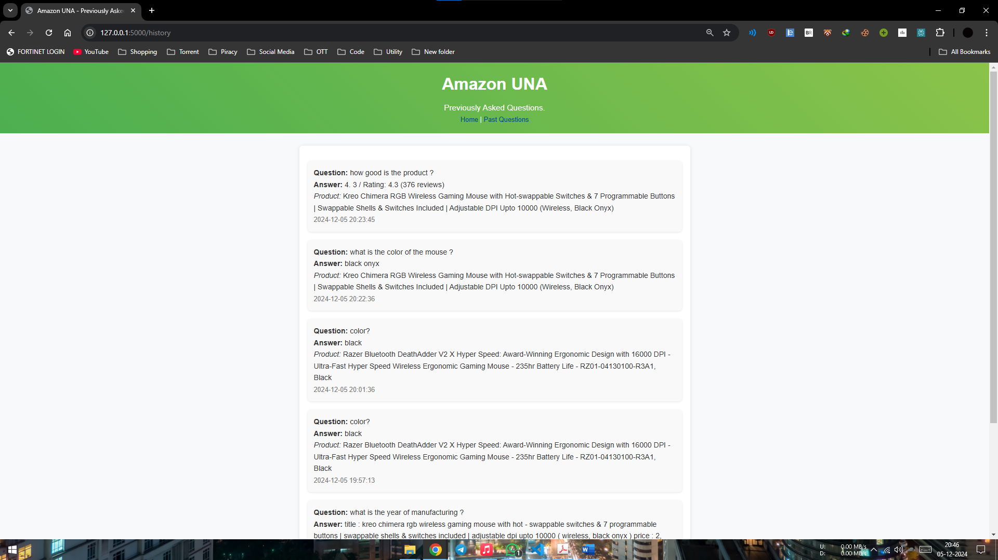
Previous questions are being stored

Slide 20
Conclusion:
The combined BERT + FLAN model achieved 73% accuracy, highlighting the effectiveness of ensemble methods.
FLAN: Mostly generated short correct answers like yes /no.
BERT: Generated descriptive answers nicely.
Combined Model: The combined model together with sentiment analysis gave a very satisfying results
The Sentiment based answer generation was not done before by anyone else which accounts for our uniqueness

Slide 21
The future scope involves:
Fine-Tuning BERT and FLAN Models to Improve Performance
Real-Time Sentiment Analysis- Process realtime customer reviews
Advanced Feedback Loop for Continuous Improvement- learning and improving from user feedback in reviews
Adding voice interaction capabilities to the system would make it more user-friendly

Slide 22
Thank You

